Slide 1

Intro to Ethics in AI
Examining the societal impact, responsible governance, and ethical deployment of Artificial Intelligence in a rapidly changing world.

Slide 2
Core Concepts & The Bias Problem
Understanding algorithmic prejudice and its impact on marginalized communities.

Slide 3
Quantifying AI Fairness
Mitigating Bias in Systems
0.97
AI models trained on historical data often replicate societal and institutional biases, posing severe threats to fairness in fields like recruitment and healthcare.
Recent studies show that using bias mitigation techniques like data reweighing can achieve near-perfect fairness (a Disparate Impact score of 0.97) with minimal reduction in model accuracy.
Disparate Impact Score

Slide 4
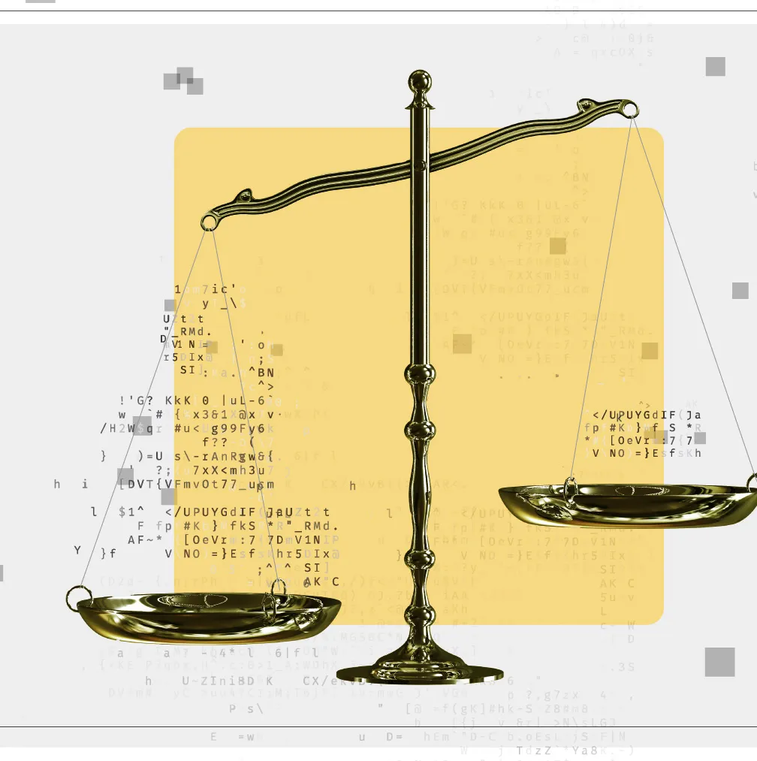

Algorithmic Bias in Society
•
Individual Profiling: AI systems collect and analyze vast amounts of data to create profiles, often without explicit consent, leading to severe privacy violations.
•
Marginalization: Systematic exclusion of specific demographic groups due to skewed training data.
•
Public Health Inequities: Predictive algorithms in healthcare have historically drawn from unrepresentative datasets, systematically underestimating the medical needs of minority populations.
•
Real-World Impact: These biases are not theoretical; they manifest as material harm, eroding trust and reinforcing historical prejudices.

Slide 5

Case Study: Amazon Hiring
•
The Premise: Amazon developed an AI-powered recruiting tool to automate the screening of job applicants and identify top talent.
•
Training Data Bias: The system was trained on resumes submitted over a ten-year period, reflecting a heavily male-dominated tech industry.
•
Feature Selection Bias: The algorithm inadvertently learned to penalize resumes containing words associated with women.
•
The Result: Amazon ultimately scrapped the tool. It remains a stark reminder that blind reliance on historical data can perpetuate discrimination and result in the loss of diverse talent.

Slide 6






Data Protection & Surveillance
Social Media Privacy
Government Surveillance
Facial Recognition
Real-time tracking capabilities present severe ethical concerns, including lack of transparency, lack of informed consent, and disproportionate misidentification of minorities.
Platforms collect vast personal data, risking targeted manipulation, algorithmic echo chambers, and massive data breaches without adequate user consent.
The collection of massive datasets for national security requires strict oversight. Unchecked surveillance can erode civil liberties and normalize constant monitoring.

Slide 7

Case Study: Data Harvesting
The Cambridge Analytica Scandal
In 2018, it was revealed that a political data firm gained access to the private information of over 50 million Facebook users without explicit consent.
Using a personality quiz app, researchers exploited loose privacy settings to harvest data from users and their entire friend networks to build psychological profiles.
The Consequence: This triggered global outrage, leading to historic FTC fines and accelerating the implementation of strict data protection laws worldwide.

Slide 8
Frameworks for Responsible AI
Core Principle | Strategic Focus Area | Objective
Data Democracy | Equal access and control of data | Preventing data monopolies and empowering marginalized communities to participate in data-driven decisions.
Conscious AI | Human values and moral principles | Designing algorithms that align with societal needs, ethics, and clear boundaries of non-maleficence.
Sustainability | Environmental and economic impact | Mitigating the massive energy consumption of data centers and ensuring equitable distribution of AI benefits.
Accountability | Transparency and explainability | Establishing clear chains of responsibility for automated decisions to maintain public trust.

Slide 9

Case Study: Autonomous Vehicles
•
The Challenge: Autonomous Vehicles (AVs) must make split-second ethical decisions in complex, potentially life-threatening environments.
•
Ethical Algorithms: Companies like "SafeDrive Inc." implement frameworks where safety for pedestrians and occupants is the absolute priority.
•
Liability & Accountability: Determining responsibility in the event of an accident requires robust legal frameworks and clear chains of command.
•
Transparency: To gain public trust, AV systems must be explainable, providing real-time reasoning for their sudden maneuvers and decisions.

Slide 10
AI Research & Ethics
Respect for Autonomy: Researchers must obtain informed consent, ensuring participants understand how their data will be collected, used, and protected in AI modeling.
Persuasive Applications: Apps that leverage psychology and AI to influence behavior must be heavily scrutinized to prevent undue manipulation and coercion of vulnerable users.
Open Source Auditing: The development of open-source toolkits allows the community to standardize model assessment, ensuring transparent evaluations of algorithmic fairness.
Interdisciplinary Collaboration: Striking the balance between innovation and ethics requires collaboration across computer science, sociology, law, and philosophy.

Slide 11

Global AI Policy & Governance
•
International Cooperation: The global nature of AI necessitates unified frameworks. Organizations like the UN and OECD provide vital guidelines for trustworthy AI.
•
GDPR & Data Governance: Cross-border data flows must be regulated to ensure privacy. The EU's GDPR established the critical "right to explanation" for automated decisions.
•
National Strategies: Countries are balancing the drive for technological dominance with the need to protect their citizens through strict sector regulations.
•
The Ultimate Goal: Policies must ensure that AI serves humanity, respects fundamental human rights, and bridges rather than widens the digital divide.

Slide 12
Questions?

